Slide 1
PHISHING -
Recognizing and Preventing Online Scams
Presented by
Athira k

Slide 2
CONTENTS
What is Phishing?
Common Types of Phishing
Recognizing Phishing emails
Recognizing Phishing websites
Recognizing Social Engineering tactics

Slide 3
What is Phishing?
Phishing is a type of cyberattack where attackers disguise themselves as legitimate entities to deceive individuals into sharing sensitive information, such as passwords, credit card numbers, or personal details.
These attacks typically come in the form of fake emails, messages, or websites that appear to be from trusted sources like banks, online services, or government agencies.
The goal of phishing is to trick the victim into taking harmful actions, such as:
Clicking on malicious links
Downloading infected attachments
Providing sensitive information

Slide 4
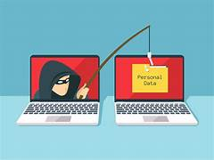
Common Types of Phishing
Email Phishing: Fake emails from trusted sources.
Spear Phishing: Targeted attacks aimed at specific individuals.
Smishing: Phishing via SMS/text messages.
Vishing: Phishing via phone calls (voice phishing).
Clone Phishing: Replicating legitimate emails with malicious links.

Slide 5
Recognizing Phishing Emails
Suspicious Sender Address:
Check the email address carefully. Phishing emails often come from addresses that look legitimate but have subtle misspellings or extra characters (e.g., support@paypai.com instead of support@paypal.com).
Generic Greetings:
Legitimate companies usually address you by your name. Be cautious if the email starts with a vague greeting like "Dear Customer" or "Dear User."
Urgent or Threatening Language:
Phishing emails often use scare tactics or urgency, such as "Your account has been compromised" or "Immediate action required." This is meant to make you act without thinking.

Slide 6
cntd…
Suspicious Links or Attachments:
Hover over links to see the actual URL before clicking. If the URL looks strange or doesn't match the company's legitimate website, it’s a red flag.
Avoid downloading attachments unless you’re sure they’re from a trusted source, as they could contain malware.
Poor Grammar and Spelling:
Many phishing emails have grammatical errors, awkward phrasing, or spelling mistakes, which are not typical of professional organizations.
Unsolicited Requests for Sensitive Information:
Be cautious if the email asks for personal information like passwords, credit card numbers, or Social Security numbers. Legitimate companies rarely request such details via email.

Slide 7
Recognizing Social Engineering Tactics
Phishing (Emails, Texts, and Calls)
Attackers send fraudulent emails, texts, or make calls impersonating a trusted source (e.g., banks, co-workers).
Signs:
Unfamiliar sender or domain names.
Requests for sensitive information (e.g., passwords, account details).
Poor grammar or urgent, threatening language (e.g., "Your account will be closed unless you act now").
Avoidance:
Verify the sender by checking their email or phone number.
Hover over links to inspect URLs before clicking.
Avoid responding to unsolicited requests for sensitive information.

Slide 8
How to Recognize a Phishing Website?
Check the URL:
Misspelled URLs: Phishing sites often use URLs that are close to the original website but have slight misspellings or extra characters (e.g., "paypa1.com" instead of "paypal.com").
Unfamiliar domain extensions: A legitimate company may use ".com" or ".org," but a phishing site might use strange extensions like ".xyz" or ".info."
HTTP vs. HTTPS: Legitimate websites use secure protocols (HTTPS), which encrypt your connection. Look for the padlock icon in the browser’s address bar.
Look for Design or Content Issues:
Poor design: Phishing websites often have lower quality design and layout compared to legitimate sites.
Grammatical errors: Many phishing sites have obvious spelling or grammatical mistakes that legitimate companies would avoid.
Low-quality logos or images: Images and logos might appear pixelated or distorted compared to the official site.

Slide 9
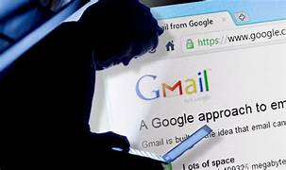
Phishing Case Study: A Real-Life Example
Case: The 2016 Gmail Phishing Scam
In 2016, a sophisticated phishing attack targeted millions of Google users, including high-profile figures such as journalists, executives, and political leaders.
The attack primarily used Gmail as the vector to steal users' credentials and compromise accounts.

Slide 10
Conclusion
Phishing attacks are becoming more sophisticated and widespread, targeting both individuals and organizations.
Recognizing phishing attempts and understanding how to avoid them is critical to safeguarding personal information and organizational data.
By staying vigilant, following best practices like using strong passwords, enabling two-factor authentication (2FA), and double-checking suspicious emails or messages, you can significantly reduce the risk of falling victim to phishing scams.
Always verify before you trust, report suspicious activities, and never share sensitive information without proper validation.

Slide 11
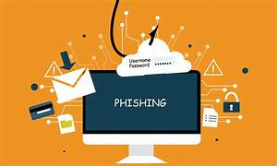
Stay alert, stay informed, and stay safe online!

Slide 12
THANK YOU!

